Slide 1
Introduction
to
Excel 2010

Slide 2
EDITING WORKSHEET

Slide 3
Objectives Overview
How to insert data in excel
How to select data in excel
How to delete data in excel
How to move data in excel
How to identify rows and columns
How to copy and paste in excel
How to find and replace
How to do spell check

Slide 4
Objectives Overview
How to zoom in-out
How to insert special symbols
How to insert comments
How to add text box

Slide 5
Insert Data in Excel 2010
In MS Excel, there are 1048576*16384 cells.
MS Excel cell can have Text, Numeric value or formulas.
An MS Excel cell can have maximum of 32000 characters.

Slide 6
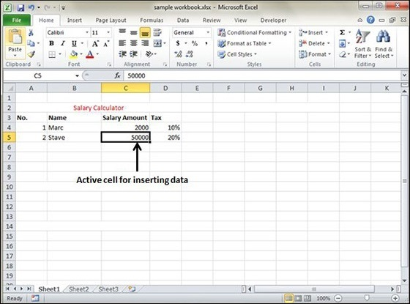
Inserting Data
For inserting data in MS Excel, just activate the cell type text or number and press enter or Navigation keys.

Slide 7
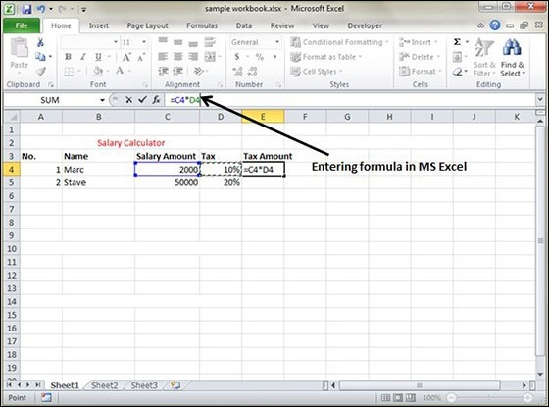
Inserting Formula
For inserting formula in MS Excel go to the formula bar, enter the formula and then press enter or navigation key. See the screen-shot below to understand it.

Slide 8
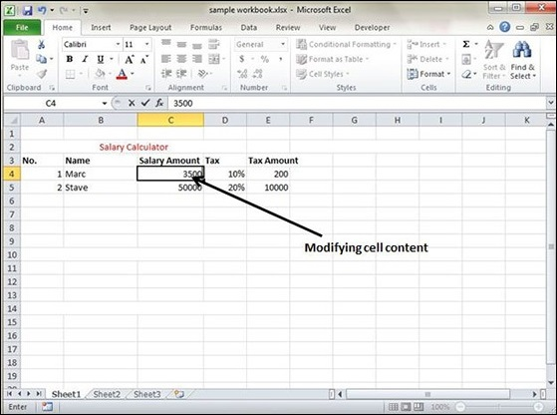
Modifying Cell Content
For modifying the cell content just activate the cell, enter a new value and then press enter or navigation key to see the changes. See the screen-shot below to understand it.

Slide 9
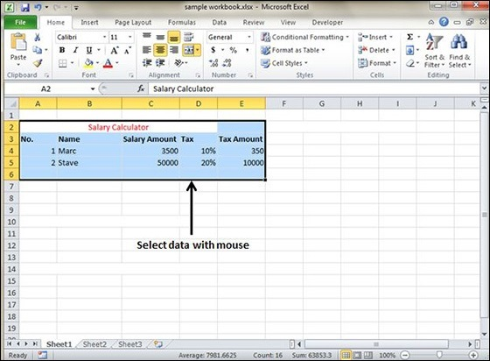
Select Data in Excel 2010
Select with Mouse
Drag the mouse over the data you want to select. It will select those cells as shown below.

Slide 10
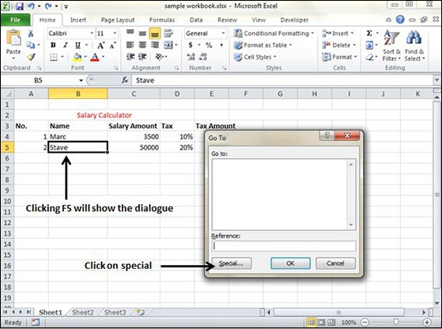
Select Data in Excel 2010
Select with Special
If you want to select specific region, select any cell in that region. Pressing F5 will show the below dialogue box.

Slide 11
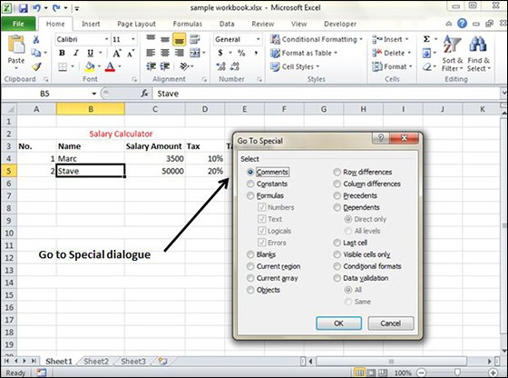
Select Data in Excel 2010
Select with Special
Click on Special button to see the below dialogue box. Select current region from the radio buttons. Click on ok to see the current region selected.

Slide 12
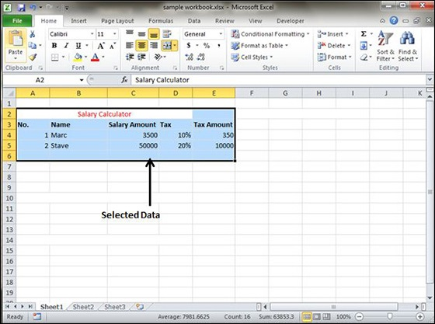
Select Data in Excel 2010
Select with Special
As you can see in the below screen, the data is selected for the current region.

Slide 13
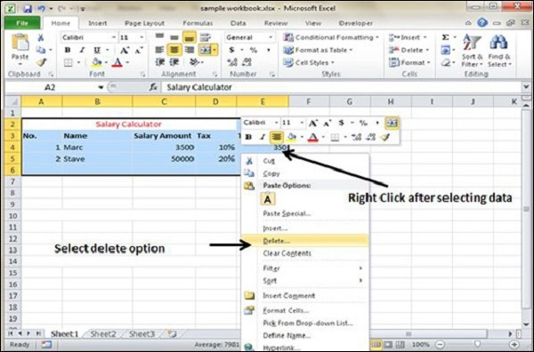
Delete Data in Excel 2010
Delete with Mouse
Select the data you want to delete. Right Click on the sheet. Select the delete option, to delete the data.

Slide 14
Delete Data in Excel 2010
Delete with Delete Key
Select the data you want to delete. Press on the Delete Button from the keyboard, it will delete the data.

Slide 15
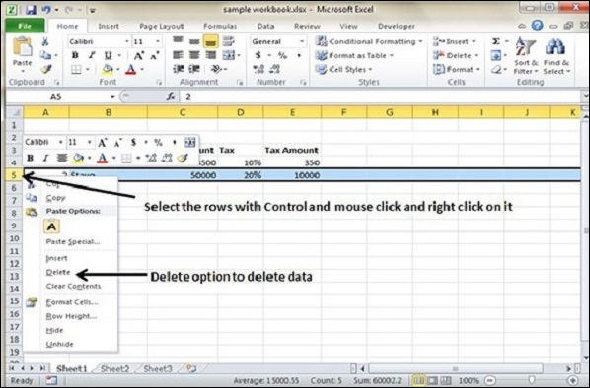
Delete Data in Excel 2010
Selective Delete for Rows
Select the rows, which you want to delete with Mouse click + Control Key.
Then right click to show the various options.
Select the Delete option to delete the selected rows.

Slide 16
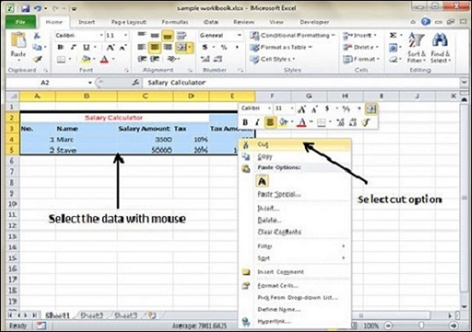
Move Data in Excel 2010
Step 1
Select the data you want to Move. Right Click and Select the cut option.

Slide 17
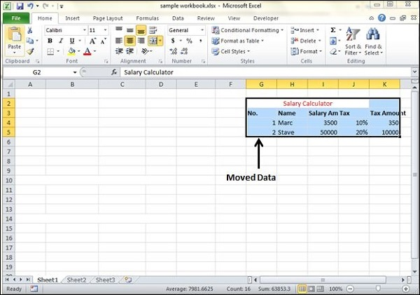
Move Data in Excel 2010
Step 2
Select the first cell where you want to move the data. Right click on it and paste the data. You can see the data is moved now.

Slide 18
Rows & Columns in Excel 2010
MS Excel is in tabular format consisting of rows and columns.
Row runs horizontally while Column runs vertically.
Each row is identified by row number, which runs vertically at the left side of the sheet.
Each column is identified by column header, which runs horizontally at the top of the sheet.

Slide 19
Rows & Columns in Excel 2010
For MS Excel 2010, Row numbers ranges from 1 to 1048576; in total 1048576 rows.
Columns ranges from A to XFD; in total 16384 columns.

Slide 20
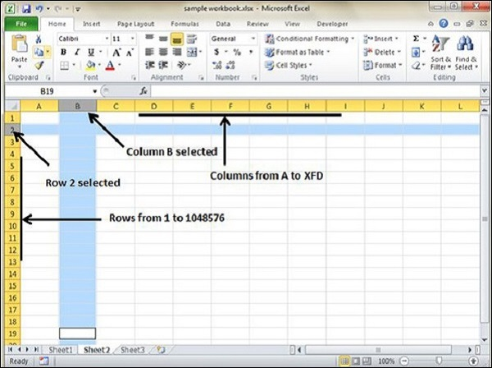
Navigation with Rows and Columns
You can go to the last row by clicking Control + Down Navigation arrow.
You can go to the last column by clicking Control + Right Navigation arrow.

Slide 21
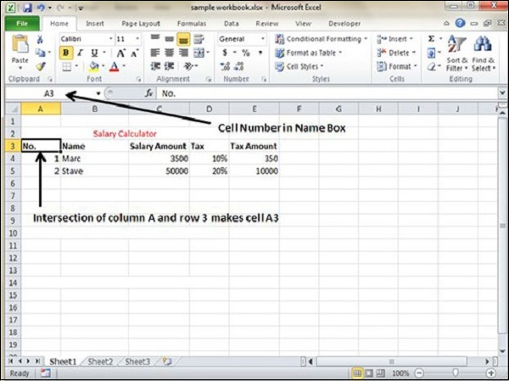
Cell Introduction
The intersection of rows and columns is called cell.
Cell is identified with Combination of column header and row number.
For example − A1, A2.

Slide 22
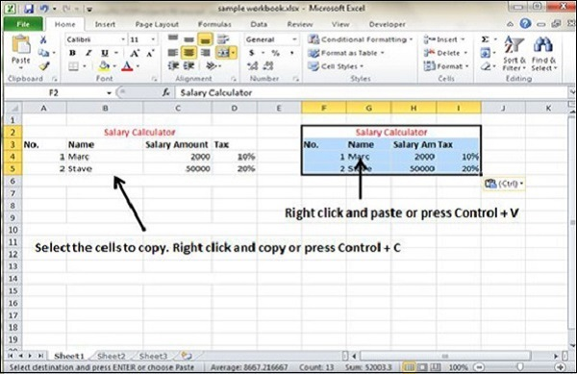
Copy & Paste in Excel 2010
To copy and paste, just select the cells you want to copy. Choose copy option after right click or press Control + C.
Select the cell where you need to paste this copied content. Right click and select paste option or press Control + V.

Slide 23
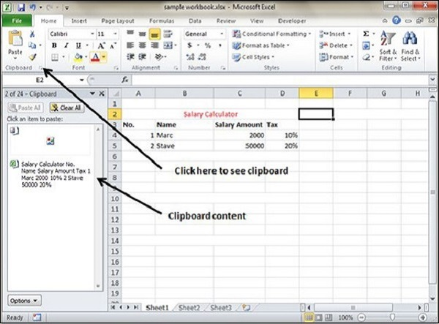
Copy Paste using Office Clipboard
When you copy data in MS Excel, it puts the copied content in Windows and Office Clipboard.
You can view the clipboard content by Home → Clipboard.
View the clipboard content.
Select the cell where you need to paste. Click on paste, to paste the content.

Slide 24
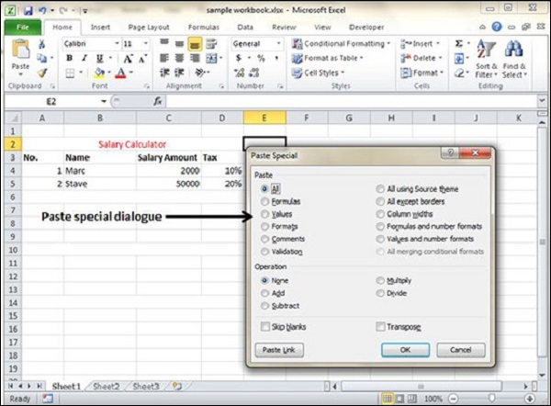
Copy Paste in Special way
Select the document you want to copy.
Select the cell where you need to paste.
Click on paste special to open the dialogue box.

Slide 25
Copy Paste in Special way
Below are the various options available in paste special.
All − Pastes the cell’s contents, formats, and data validation from the Windows Clipboard.
Formulas − Pastes formulas, but not formatting.
Values − Pastes only values not the formulas.
Formats − Pastes only the formatting of the source range.

Slide 26
Copy Paste in Special way
Below are the various options available in paste special.
Comments − Pastes the comments with the respective cells.
Validation − Pastes validation applied in the cells.
All using source theme − Pastes formulas, and all formatting.
All except borders − Pastes everything except borders that appear in the source range.

Slide 27
Copy Paste in Special way
Below are the various options available in paste special.
Column Width − Pastes formulas, and also duplicates the column width of the copied cells.
Formulas & Number Formats − Pastes formulas and number formatting only.
Values & Number Formats − Pastes the results of formulas, plus the number.

Slide 28
Copy Paste in Special way
Below are the various options available in paste special.
Merge Conditional Formatting − This icon is displayed only when the copied cells contain conditional formatting. When clicked, it merges the copied conditional formatting with any conditional formatting in the destination range.
Transpose − Changes the orientation of the copied range. Rows become columns, and columns become rows. Any formulas in the copied range are adjusted so that they work properly when transposed.

Slide 29
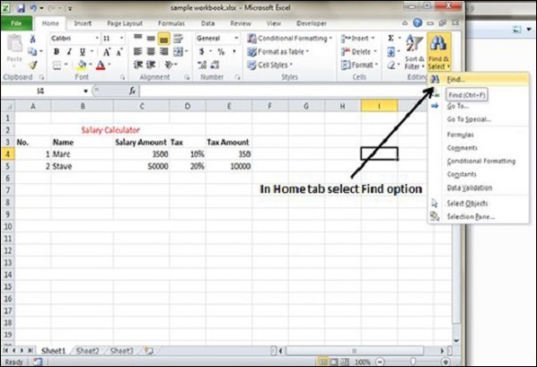
Find and Replace Dialogue
To access the Find & Replace, Choose Home → Find & Select → Find or press Control + F Key.

Slide 30
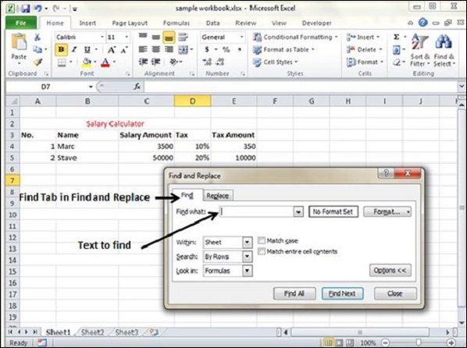
Find and Replace Dialogue
You can see the Find and Replace dialogue as below.

Slide 31
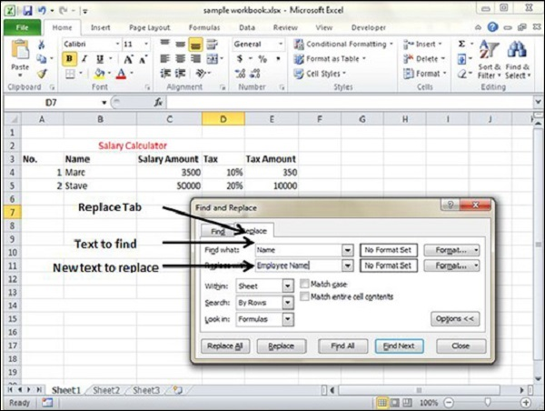
Find and Replace Dialogue
You can replace the found text with the new text in the Replace tab.

Slide 32
Find and Replace Dialogue
Now, let us see the various options available under the Find dialogue.
Within − Specifying the search should be in Sheet or workbook.
Search By − Specifying the internal search method by rows or by columns.
Look In − If you want to find text in formula as well, then select this option.
Match Case − If you want to match the case like lower case or upper case of words, then check this option.
Match Entire Cell Content − If you want the exact match of the word with cell, then check this option.

Slide 33
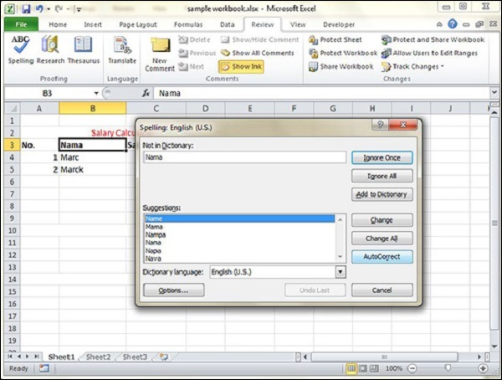
Spell Check in Excel 2010
To access the spell checker, Choose Review ➪ Spelling or press F7.
To check the spelling in just a particular range, select the range before you activate the spell checker.
If the spell checker finds any words it does not recognize as correct, it displays the Spelling dialogue with suggested options.

Slide 34
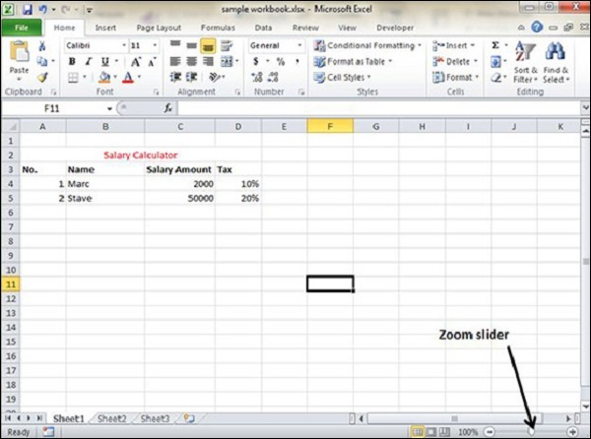
Zoom In/Out in Excel 2010
By default, everything on screen is displayed at 100% in MS Excel.
You can change the zoom percentage from 10% (Minimum) to 400% (Maximum).
Zooming doesn’t change the font size, so it has no effect on the printed output.

Slide 35
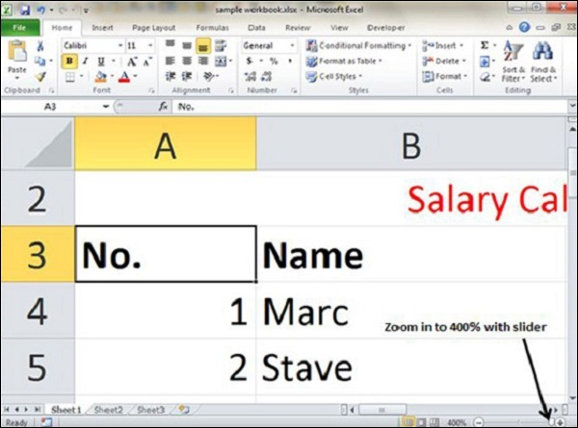
Zoom In
You can zoom in the workbook by moving the slider to the right.
It will change the only view of the workbook.

Slide 36
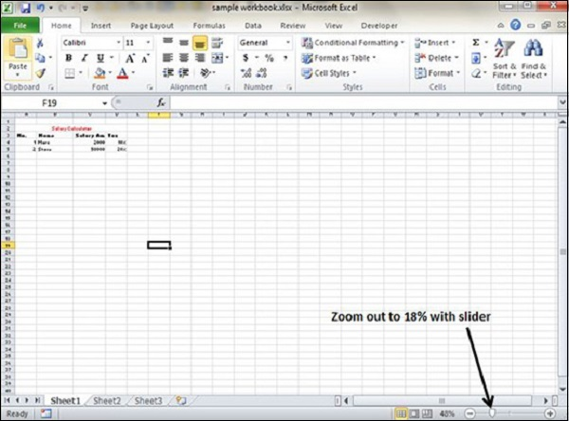
Zoom Out
You can zoom out the workbook by moving the slider to the left.
It will change the only view of the workbook.

Slide 37


Slide 38
THANK YOU

